Slide 1

Kotlin Syntax
Produced
by:
Dr. Siobhán Drohan (sdrohan@wit.ie)
Department of Computing and Mathematics
http://www.wit.ie/

Slide 2

Kotlin Syntax
Sources: http://kotlinlang.org/docs/reference/basic-syntax.html
http://petersommerhoff.com/dev/kotlin/kotlin-for-java-devs/

Slide 3
Agenda
Basic Types
Local Variables (val & var)
Functions
Control Flow (if, when, for, while)
Strings & String Templates
Ranges (and the in operator)
Type Checks & Casts
Null Safety
Comments

Slide 4
Basic Types
Numbers, characters and booleans.

Slide 5

Basic Types
In Kotlin, everything is an object in the sense that we can call member functions and properties on any variable.

Slide 6
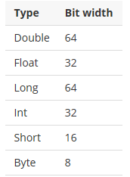
Basic Types - Numbers

Slide 7

Basic Types - Numbers
val doubleNumber: Double = 100.45
val floatNumber: Float = 100.45f
val longNumber: Long = 100
val intNumber: Int = 100
val shortNumber: Short = 100
val byteNumber: Byte = 100
Explicitly defining a numeric type

Slide 8

Basic Types - Numbers
val doubleNumber = 100.45
val floatNumber = 100.45f
val longNumber = 100L
val intNumber = 100
val shortNumber = 100
val byteNumber = 100
Type inference

Slide 9
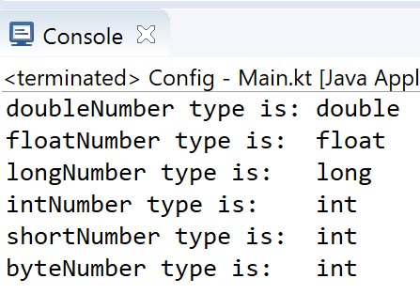

Basic Types - Numbers
val doubleNumber = 100.45
val floatNumber = 100.45f
val longNumber = 100L
val intNumber = 100
val shortNumber = 100
val byteNumber = 100
Type inference
println("doubleNumber type is: " + doubleNumber.javaClass)
println("floatNumber type is: " + floatNumber.javaClass)
println("longNumber type is: " + longNumber.javaClass)
println("intNumber type is: " + intNumber.javaClass)
println("shortNumber type is: " + shortNumber.javaClass)
println("byteNumber type is: " + byteNumber.javaClass)

Slide 10
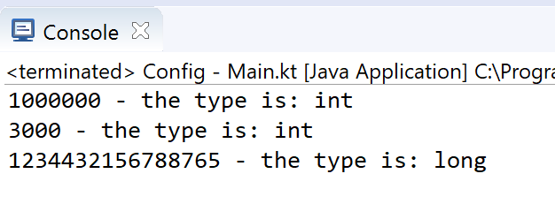

Basic Types - Numbers
val oneMillion = 1_000_000
val threeThousand = 3_000
val creditCardNumber = 1234_4321_5678_8765
fun main(args : Array<String>)
{
println("" + oneMillion + " - the type is: " + oneMillion.javaClass)
println("" + threeThousand + " - the type is: " + threeThousand.javaClass)
println("" + creditCardNumber + " - the type is: " + creditCardNumber.javaClass)
}
You can use underscores to make number constants more readable.

Slide 11
Basic Types – Numbers: Explicit Conversions
In Kotlin, there are no implicit widening conversions for numbers i.e.
smaller types (e.g. Byte) are not subtypes of bigger ones (e.g. Int)
→ smaller types are NOT implicitly converted to bigger types.

Slide 12

Basic Types – Numbers: Explicit Conversions
In Kotlin, there are no implicit widening conversions for numbers i.e.
smaller types (e.g. Byte) are not subtypes of bigger ones (e.g. Int)
→ smaller types are NOT implicitly converted to bigger types.
val byteNumber: Byte = 10 //static type check: OK
val intNumber: Int = byteNumber //syntax error
BUT, we can use explicit conversions to widen numbers
val byteNumber: Byte = 10 //static type check: OK
val intNumber: Int = byteNumber.toInt() //OK

Slide 13

Basic Types – Numbers: Explicit Conversions
Every number type supports the following conversions:
toByte(): Byte
toShort(): Short
toInt(): Int
toLong(): Long
toFloat(): Float
toDouble(): Double
toChar(): Char
//Explicit Conversion
val intNumber: Int = byteNumber.toInt()
val floatNumber: Float = byteNumber.toFloat()

Slide 14
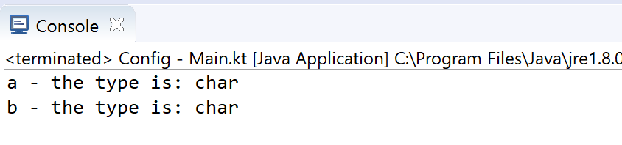

Basic Types – Characters
val aChar = 'a'
val bChar: Char = 'b'
fun main(args : Array<String>)
{
println("" + aChar + " - the type is: " + aChar.javaClass)
println("" + bChar + " - the type is: " + bChar.javaClass)
}

Slide 15
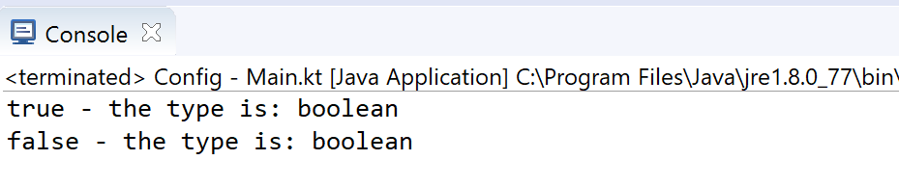

Basic Types – Booleans
val aFlag = true
val bFlag: Boolean = false
fun main(args : Array<String>)
{
println("" + aFlag + " - the type is: " + aFlag.javaClass)
println("" + bFlag + " - the type is: " + bFlag.javaClass)
}

Slide 16
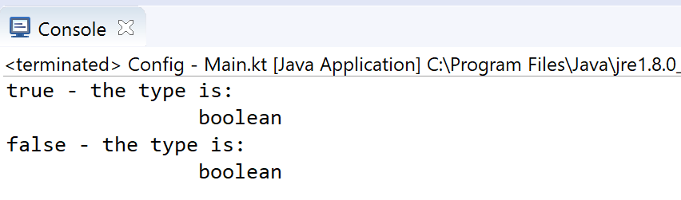

Basic Types – Escape Characters
Special characters can be escaped using a backslash:
\t \b \n \r \’ \“ \\ \$
val aFlag= true
val bFlag: Boolean = false
fun main(args : Array<String>)
{
println("" + aFlag + " - the type is: \n\t\t" + aFlag.javaClass)
println("" + bFlag + " - the type is: \n\t\t" + bFlag.javaClass)
}

Slide 17
Local Variables
val (read-only) and var (mutable)

Slide 18
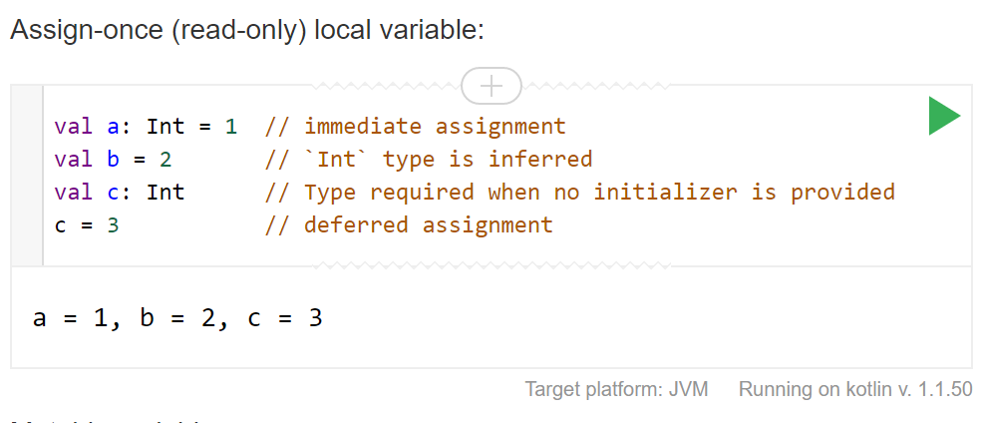

Local Variables – val (read-only)

Slide 19
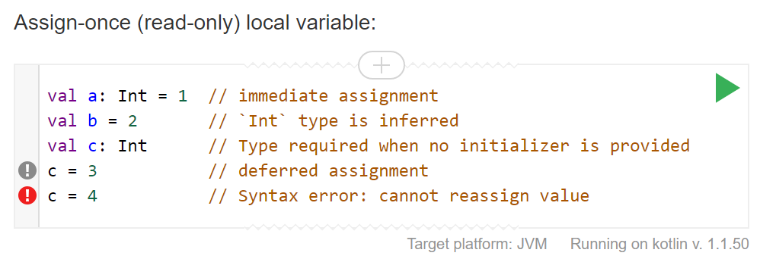

Local Variables – val (read-only)

Slide 20
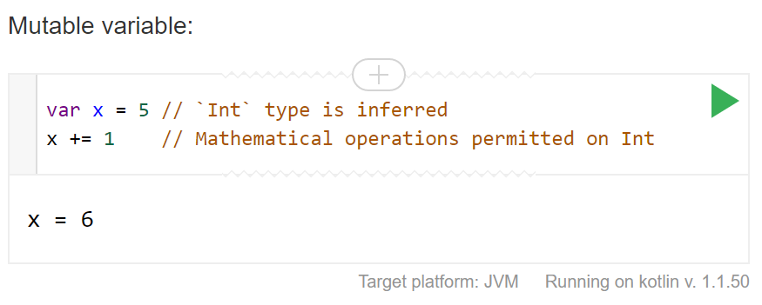

Local Variables – var (mutable)

Slide 21
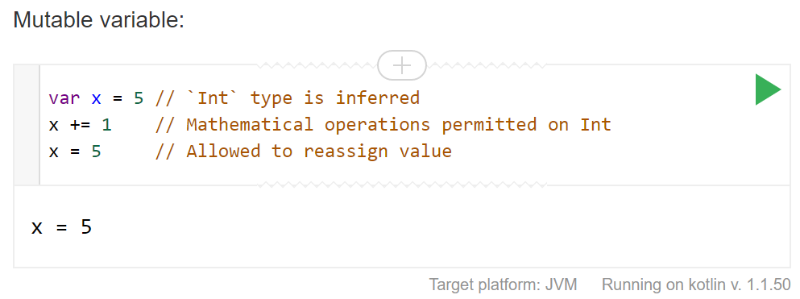
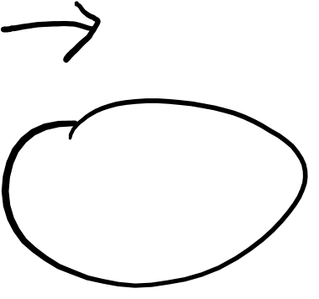
Local Variables – var (mutable)

Slide 22
Functions
Parameters, return types, expression body, inferred return type

Slide 23
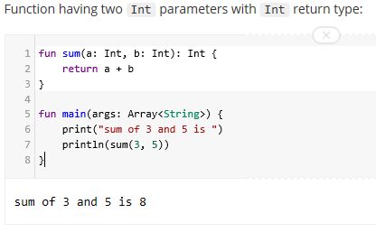

Functions – parameters and return types

Slide 24
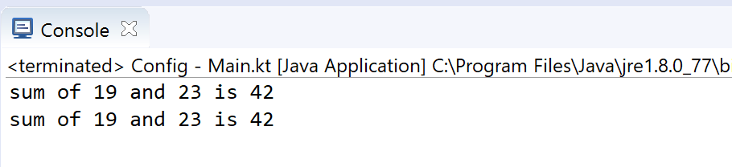

Functions – expression body, inferred return type
Function “sum” with an expression body and inferred return type
fun sum(a: Int, b: Int) = a + b
fun main(args: Array<String>) {
println("sum of 19 and 23 is ${sum(19, 23)}")
println("sum of 19 and 23 is " + sum(19, 23))
}

Slide 25
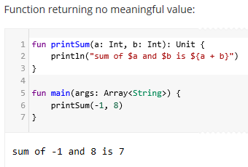
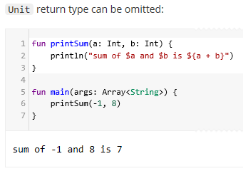

Functions – no return data

Slide 26
Control Flow
if, when, for, while

Slide 27
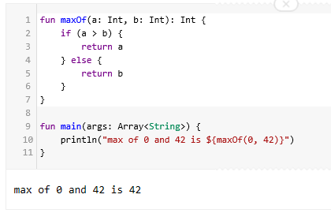

Control Flow – if
The traditional way to write if’s

Slide 28
Control Flow – if
The traditional way to write if’s
HOWEVER….in Kotlin, if is an expression, i.e. it returns a value. Therefore there is no ternary operator (condition ? then : else), because ordinary if works fine in this role.

Slide 29
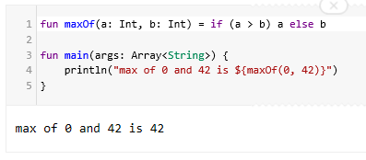

Control Flow – if
Using if as an expression

Slide 30
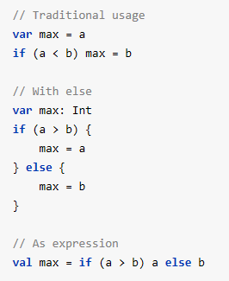

Control Flow – if
Some examples without using functions.
The first two examples use if as a statement.
The last example uses if as an expression.

Slide 31

Control Flow – if
if branches can also be blocks.
The last expression is the value of a block:
val a = 10;
val b = 5;
val max = if (a > b) {
print ("Choose a")
a
}
else {
print ("Choose b")
b
}

Slide 32
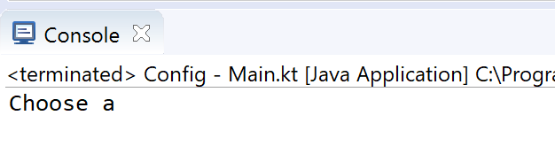
Control Flow – if
if branches can also be blocks.
The last expression is the value of a block:
val a = 10;
val b = 5;
val max = if (a > b) {
print ("Choose a")
a
}
else {
print ("Choose b")
b
}
When if is used as an expression, the else part is mandatory.

Slide 33
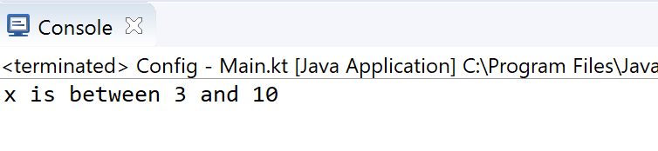

Control Flow – when
Replaces switch in Java
val x = 10;
when (x){
1 -> print("x is 1")
2 -> print("x is 2")
in 3..10 -> print ("x is between 3 and 10")
}

Slide 34
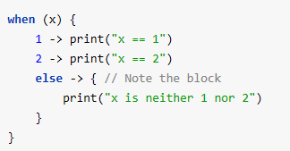

Control Flow – when

Slide 35
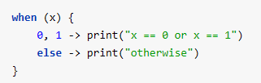
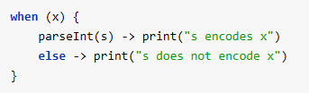
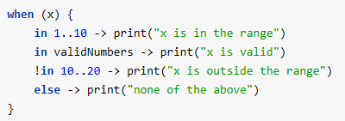

Control Flow – when
Branch conditions may be combined with a comma.
We can use arbitrary expressions (not only constants) as branch conditions.
We can also check a value for being in or !in a range or a collection.

Slide 36
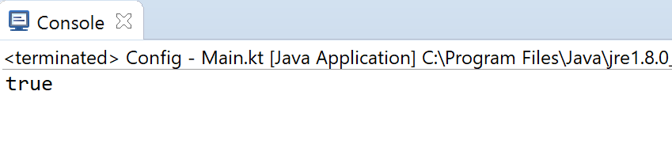

Control Flow – when
val x = "I am a String"
val contains = when (x){
is String -> x.contains("I am a")
else -> false
}
println(contains)
Another possibility is to check that a value is or !is of a particular type.

Slide 37
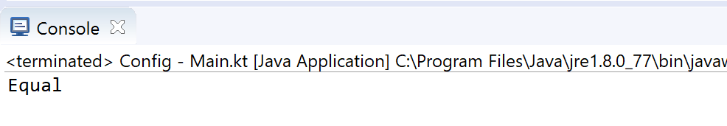

Control Flow – when
when can also be used as a replacement for an if-else if chain.
If no argument is supplied, the branch conditions are simply boolean expressions, and a branch is executed when its condition is true.
val aString = "I am a String"
when {
aString.equals("I am a String") -> println("Equal");
else -> println("Not Equal")
}

Slide 38
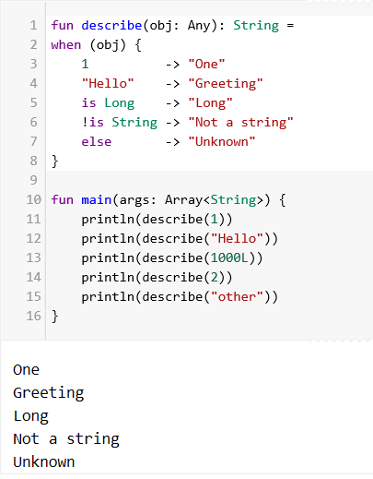

Control Flow – when

Slide 39

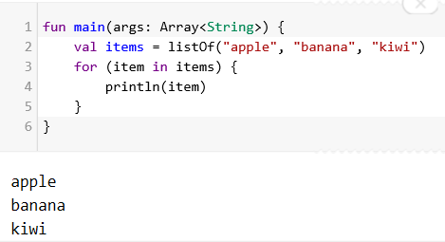

Control Flow – for
The for loop iterates through anything that provides an iterator. It is similar to the for-each loop in Java.

Slide 40
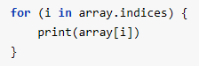
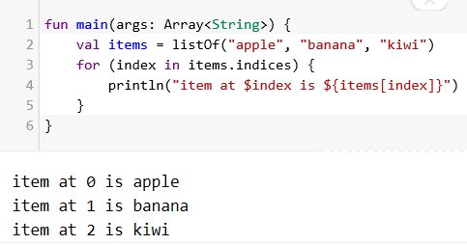

Control Flow – for
If you want to iterate through an array or a list with an index, you can do it this way:

Slide 41
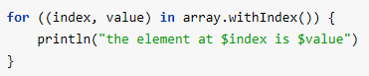
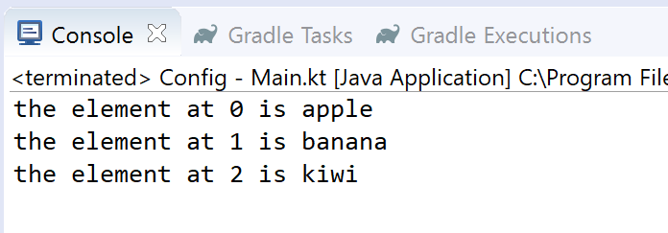

Control Flow – for
Alternatively, you can use the withIndex library function:
fun main(args: Array<String>) {
val items = listOf("apple", "banana", "kiwi")
for ((index, value) in items.withIndex()) {
println("the element at ${index} is ${value}")
}
}

Slide 42
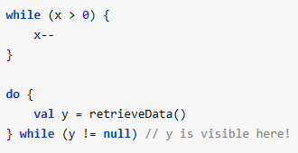

Control Flow – while
The while and do-while work as usual:
Note: Kotlin also supports traditional break and continue operators in loops.

Slide 43
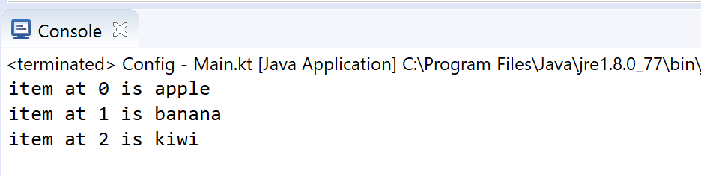

Control Flow – while
val items = listOf("apple", "banana", "kiwi")
var index = 0
while (index < items.size){
println("item at $index is ${items[index]}")
index++
}

Slide 44
Strings and String Templates
Escaped strings, raw strings, literals, templates

Slide 45
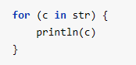

Strings
Strings are represented by the type String.
Strings are immutable.
Elements of a string are characters that can be accessed by the indexing operation: s[i].
A string can be iterated over with a for-loop:

Slide 46
String Literals
Kotlin has two types of string literals: escaped strings that may have escaped characters in them and raw strings that can contain newlines and arbitrary text.

Slide 47
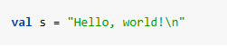
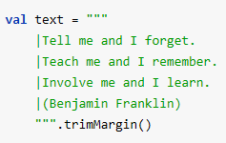

String Literals
Kotlin has two types of string literals: escaped strings that may have escaped characters in them and raw strings that can contain newlines and arbitrary text.
An escaped string is very much like a Java string
A raw string is delimited by a triple quote (“””), contains no escaping and can contain new lines and any other characters.

Slide 48
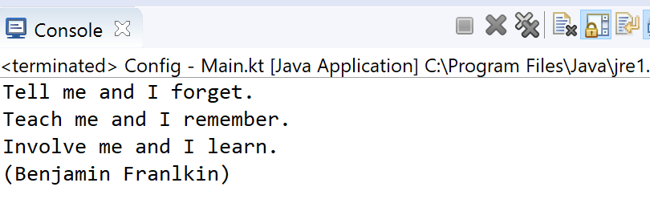

String Literals
You can remove leading whitespace with trimMargin()

Slide 49
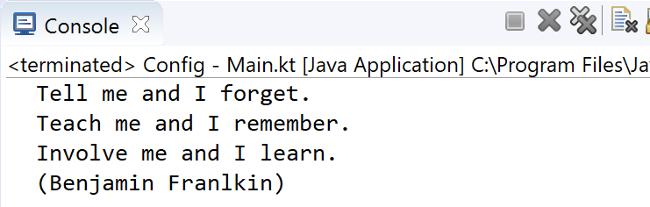
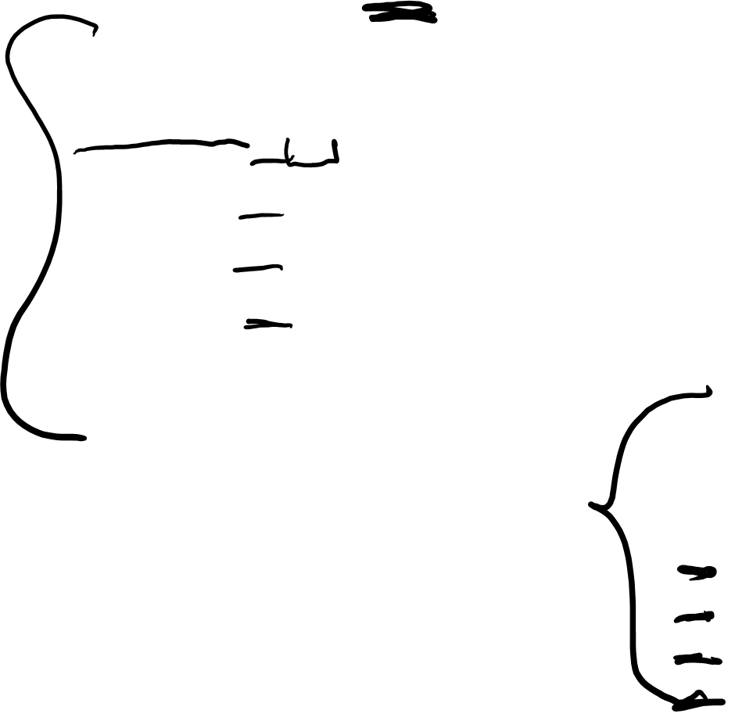
String Literals
By default | is used as margin prefix, but you can choose another character and pass it as a parameter like trimMargin(">").
val text = """
> Tell me and I forget.
> Teach me and I remember.
> Involve me and I learn.
> (Benjamin Franlkin)
""".trimMargin(">")
print(text)
Note the impact of the two spaces we put between > and the text

Slide 50
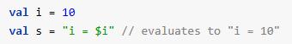

String Templates
Strings may contain template expressions, i.e. pieces of code that are evaluated and whose results are concatenated into the string.
A template expression starts with a dollar sign ($) and consists of either a simple name:
or an arbitrary expression in curly braces:

Slide 51
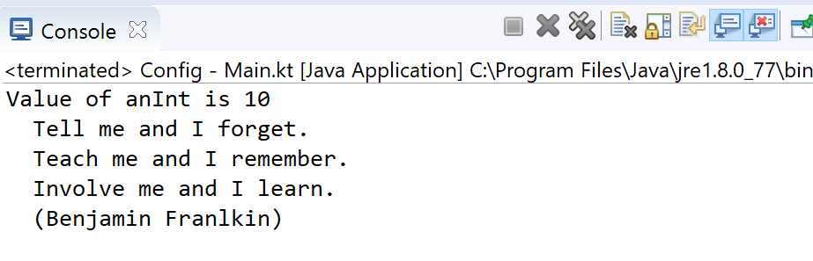
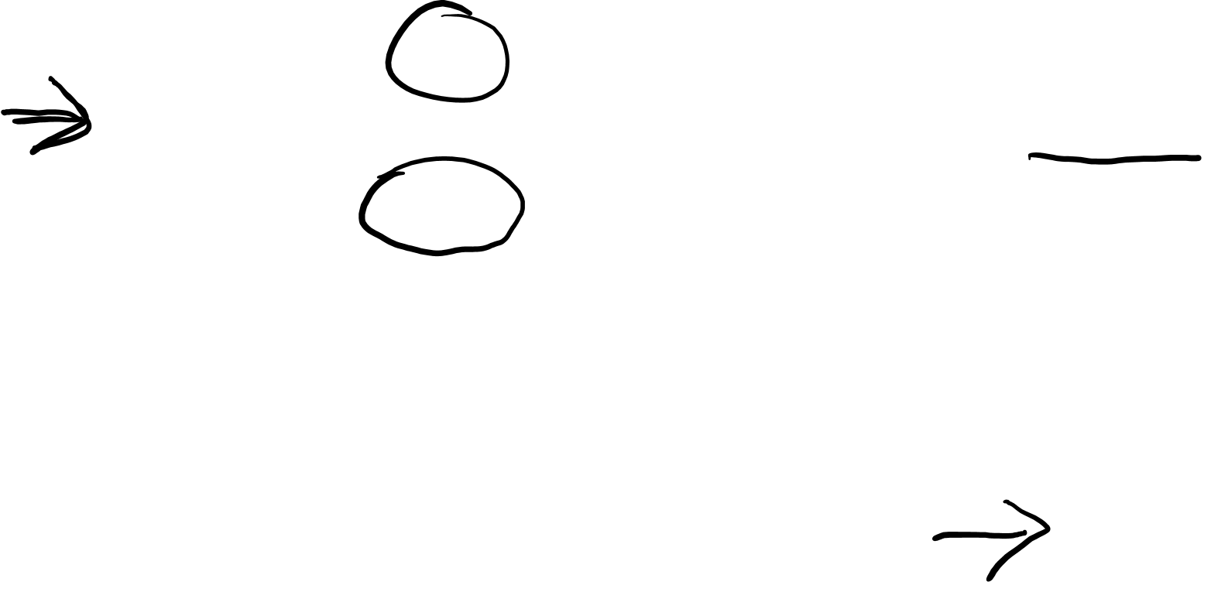
String Templates
Templates are supported both inside raw strings and inside escaped strings.
val anInt = 10
val aString = "Value of anInt is ${anInt}\n"
val text = """
> Tell me and I forget.
> Teach me and I remember.
> Involve me and I learn.
> (Benjamin Franlkin)
""".trimMargin(">")
print(aString)
print(text)

Slide 52
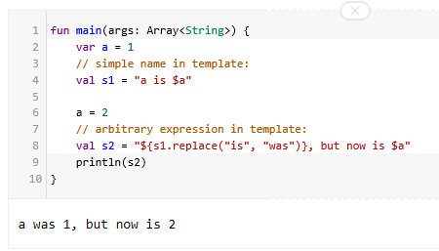

String Templates
s1
“a is 1”

Slide 53
Ranges
The in operator

Slide 54
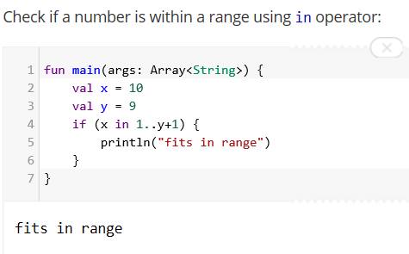
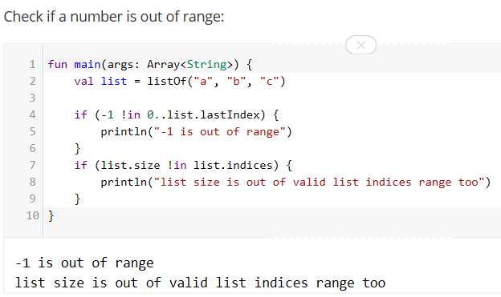
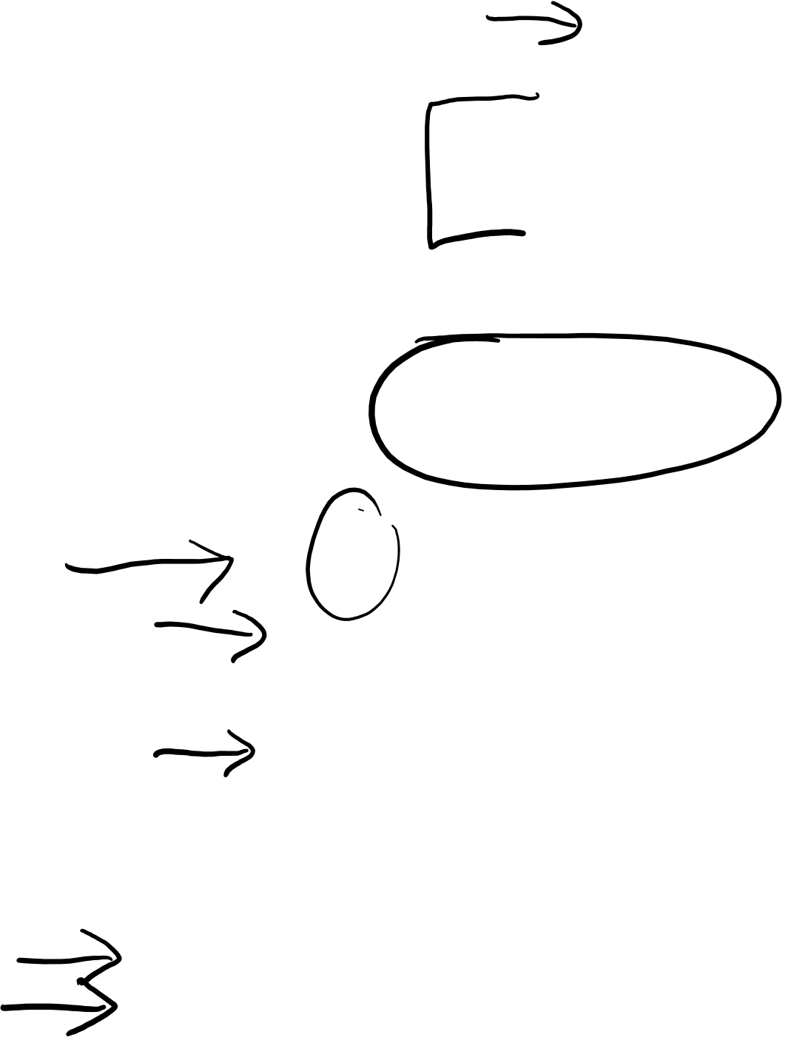
Range
Check if a number is within a range using in operator:
Check if a number is out of range:

Slide 55
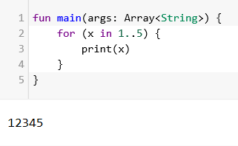
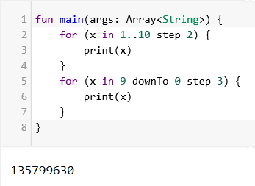

Range
Iterating over a range:
Iterating over a progression:

Slide 56
Type Checks & Casts

Slide 57
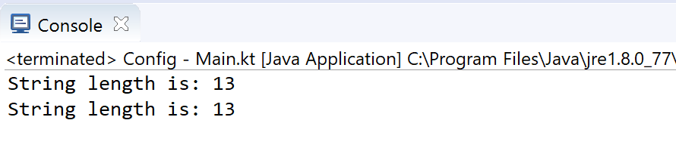

is and !is operators
fun main(args: Array<String>) {
val aString = "I am a String"
if (aString is String) {
println("String length is: ${aString.length}")
}
if (aString !is String) { // same as !(aString is String)
print("Not a String")
}
else {
println("String length is: ${aString.length}")
}
}

Slide 58


Smart Casts (an example using if)
fun main(args: Array<String>) {
demo ("I am a String")
demo (12)
}
fun demo(x: Any) {
if (x is String) {
println(x.length) // x is automatically cast to String
}
else{
println(x.javaClass)
}
}

Slide 59


Smart Casts (an example using when)
fun main(args: Array<String>) {
demo (12)
demo ("I am a String")
demo (intArrayOf(1,2,3,4))
}
fun demo(x: Any) {
when (x) {
is Int -> println(x + 1)
is String -> println(x.length + 1)
is IntArray -> println(x.sum())
}
}

Slide 60
Null
Using nullable values and checking for null

Slide 61

Null Safety
In Kotlin, the type system distinguishes between references that can hold
null (nullable references)
and those that cannot (non-null references).
The Kotlin compiler makes sure you don’t, by accident, operate on a variable that is null.

Slide 62

Null Safety – a non-null reference
A regular variable of type String can not hold null
var a: String = "abc"
a = null // syntax error
Calling a method / accessing a property on variable a, is guaranteed not to cause an NullPointerException
val l = a.length

Slide 63

Null Safety – a nullable reference
To allow nulls, we can declare a variable as nullable string, written String?
var b: String? = "abc"
b = null // ok
val l = b.length // syntax error: variable
//'b' can be null
// …many ways around this…

Slide 64
Null Safety – a nullable reference
To allow nulls, we can declare a variable as nullable string, written String?
var b: String? = "abc"
b = null // ok
Option 1: you can explicitly check if b is null, and handle the two options separately:
val l = if (b != null) b.length else -1

Slide 65

Null Safety – a nullable reference
To allow nulls, we can declare a variable as nullable string, written String?
var b: String? = "abc"
b = null // ok
Option 2: you can use the safe call operator ?.
This returns b.length if b is not null, and null otherwise.
b?.length

Slide 66

Null Safety – a nullable reference
:
To allow nulls, we can declare a variable as nullable string, written String?
var b: String? = "abc"
b = null // ok
Option 3: you can use the !! Operator. This force a call to our method and will return a non-null value of b or throw an NPE if b is null. Use sparingly!
val l = b!!.length

Slide 67
Null Safety – The Elvis Operator, ?:
:
When we have a nullable reference r, we can say:
"if r is not null, use it, otherwise use some non-null value x"
val l: Int = if (b != null) b.length else -1

Slide 68

Null Safety – The Elvis Operator, ?:
:
When we have a nullable reference r, we can say:
"if r is not null, use it, otherwise use some non-null value x"
val l: Int = if (b != null) b.length else -1
Along with the complete if-expression, this can be expressed with the Elvis operator, written ?:
val l = b?.length ?: -1
If the expression to the left of ?: is not null, the elvis operator returns it, otherwise it returns the expression to the right.

Slide 69


Nullable – nullable returns
A reference must be explicitly marked as nullable (i.e. ?) when null value is possible.
Return null if the return value does not hold an integer:

Slide 70
Comments
Single line, block, KDoc

Slide 71


Comments – single line and block comments

Slide 72


Comments – KDoc (equivalent to JavaDoc)

Slide 73
Comments – KDoc
Block tags | Currently supported KDoc block tags
@param <name> | Documents a value parameter of a function or a type parameter of a class, property or function.
@return | Documents the return value of a function.
@constructor | Documents the primary constructor of a class.
@receiver | Documents the receiver of an extension function.
@property <name> | Documents the property of a class which has the specified name.
@throws <class>, @exception <class> | Documents an exception which can be thrown by a method.
@sample <identifier> | Embeds the body of the function with the specified qualified name into the documentation for the current element, in order to show an example of how the element could be used.
@see <identifier> | Adds a link to the specified class or method to the See Also block of the documentation.
@author | Specifies the author of the element being documented.
@since | Specifies the version of the software in which the element being documented was introduced.
@suppress | Excludes the element from the generated documentation. Can be used for elements which are not part of the official API of a module but still have to be visible externally.
For more info: http://kotlinlang.org/docs/reference/kotlin-doc.html

